Slide 1
GAN
主講人:范竣凱

Slide 2
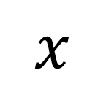
Network as Generator
$$x$$
Network
Generator
Simple distribution
Complex distribution

Slide 3
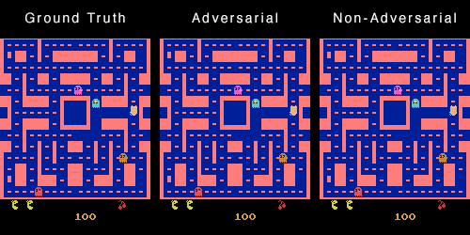
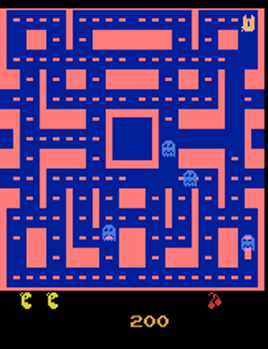
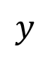
Why distribution?
Source: https://github.com/dyelax/Adversarial_Video_Generation
Video Prediction
Network
$$y$$
Previous frames
next frame
Real Video
Notes:
Not all the problem can be solved by a function.
This world has randomness. Nothing is sure. We are lack of some information to make decision.
You may be confused about how to add z.

Slide 4
Why distribution?
Source: https://github.com/dyelax/Adversarial_Video_Generation
turn
right
Video Prediction
Network
$$y$$
???
Previous frames
turn
left
Prediction
Notes:
Not all the problem can be solved by a function.
This world has randomness. Nothing is sure. We are lack of some information to make decision.

Slide 5

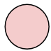
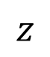
Why distribution?
Source: https://github.com/dyelax/Adversarial_Video_Generation
Video Prediction
Network
Previous frames
$$z$$
Prediction
Simple Distribution
Notes:
Z can be directly added to the input.
Z can be drop out …
===
For example, binary distribution

Slide 6

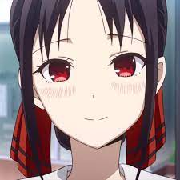
為什麼需要分布?
(The same input has different outputs.)
為了要讓機器富有’創造力’
Drawing
Character
with red eyes
Network
Chatbot
他是碩0新生…
你知道竣凱是誰嗎?
Network
他是一個男生…
Notes:
Example:
Drawing
Chatbot

Slide 7
Generative Adversarial Network

Slide 8
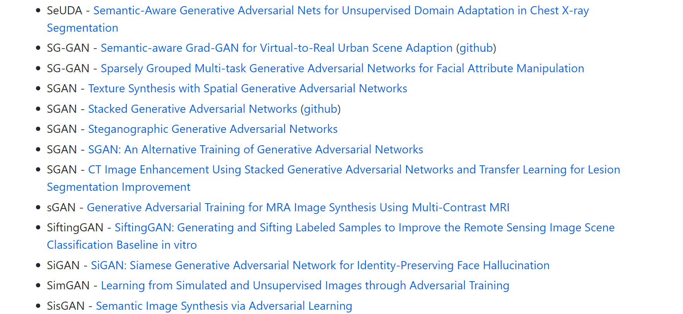
All Kinds of GAN …
https://github.com/hindupuravinash/the-gan-zoo
GAN
ACGAN
BGAN
CGAN
DCGAN
EBGAN
fGAN
GoGAN
……
Mihaela Rosca, Balaji Lakshminarayanan, David Warde-Farley, Shakir Mohamed, “Variational Approaches for Auto-Encoding Generative Adversarial Networks”, arXiv, 2017
Notes:
DeepMind

Slide 9


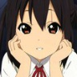
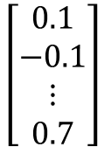
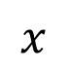
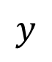
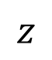
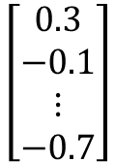
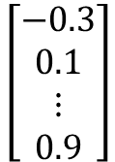
Anime Face Generation
Unconditional generation
Low-dim
vector
$$x$$
$$\left[\begin{aligned}0.3 \\ −0.1 \\ ⋮ \\ −0.7\end{aligned}\right]$$
$$\left[\begin{aligned}0.1 \\ −0.1 \\ ⋮ \\ 0.7\end{aligned}\right]$$
$$\left[\begin{aligned}−0.3 \\ 0.1 \\ ⋮ \\ 0.9\end{aligned}\right]$$
Generator
$$y$$
Complex Distribution
$$z$$
Normal Distribution
high-dim
vector
Notes:
You define the dimension! How to determine your dim???
===
We will control what to generate latter. $→$ Conditional Generation

Slide 10

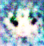
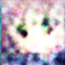
Discriminator
It is a neural network (that is, a function).
Discri-minator
圖片
Scalar: 數值越大越接近真實, 越小代表越不像.
Discri-minator
Discri-minator
1.0
1.0
Discri-minator
Discri-minator
0.1
0.1

Slide 11
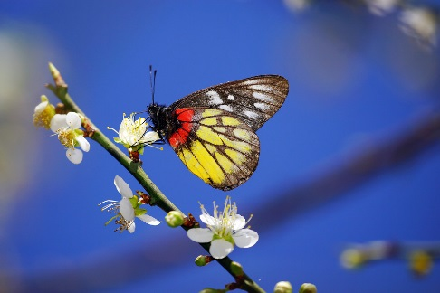
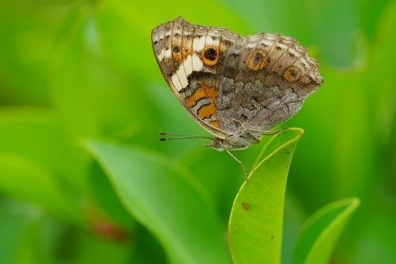
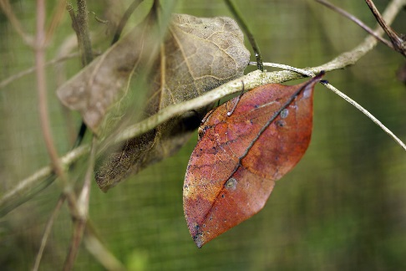
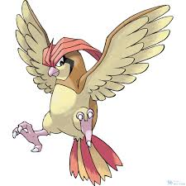
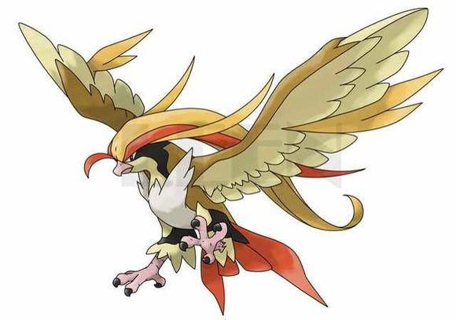
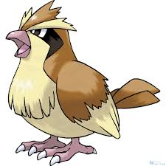
Basic Idea of GAN
Generator
Brown
veins
Butterflies are not brown
Butterflies do not have veins
……..
Discriminator
Notes:
http://peellden.pixnet.net/blog/post/40406899-2013-%E7%AC%AC%E5%9B%9B%E5%AD%A3%EF%BC%8C%E5%86%AC%E8%9D%B6%E5%AF%82%E5%AF%A5
Kallima inachus
Vein
dried leaf

Slide 12
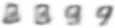
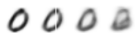
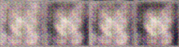
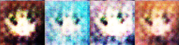
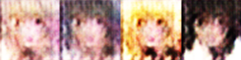
Basic Idea of GAN
This is where the term “adversarial” comes from.
NN
Generator
v1
NN
Generator
v2
NN
Generator
v3
Discri-minator
v1
Discri-minator
v2
Discri-minator
v3
Real images:
Notes:
Binary
Classifier

Slide 13




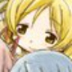


Algorithm
G
D
初始化 generator and discriminator
In each training iteration:
Step 1: 固定住 generator G, 更新 discriminator D
sample
Update
1
1
1
1
D
generated objects
二次元
資料集
0
0
0
0
randomly sampled
G
vector
Fix
vector
vector
vector
Discriminator 學習越像真實物件輸出高的分數，越不像的輸出較低的分數.

Slide 14
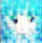
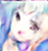
Algorithm
G
D
初始化 generator and discriminator
In each training iteration:
Step 2:固定住 discriminator D,更新 generator G
Generator learns to “fool” the discriminator
hidden layer
NN
Generator
Discri-minator
0.13
vector
update
fix
large network

Slide 15
Algorithm
G
D
Initialize generator and discriminator
In each training iteration:
Sample some real objects:
Update
1
1
1
1
Learning
D
D
Generate some fake objects:
0
0
0
0
G
vector
fix
vector
vector
vector
Learning
G
image
G
image
D
1
vector
image
vector
vector
vector
image
update
fix

Slide 16
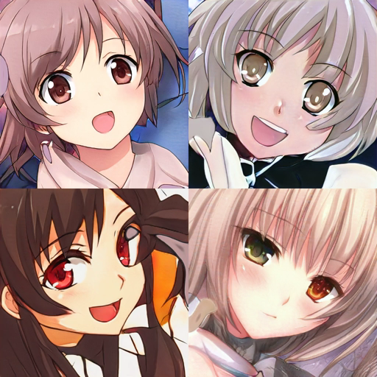
In 2019, with StyleGAN ……
Source of video:
https://www.gwern.net/Faces

Slide 17
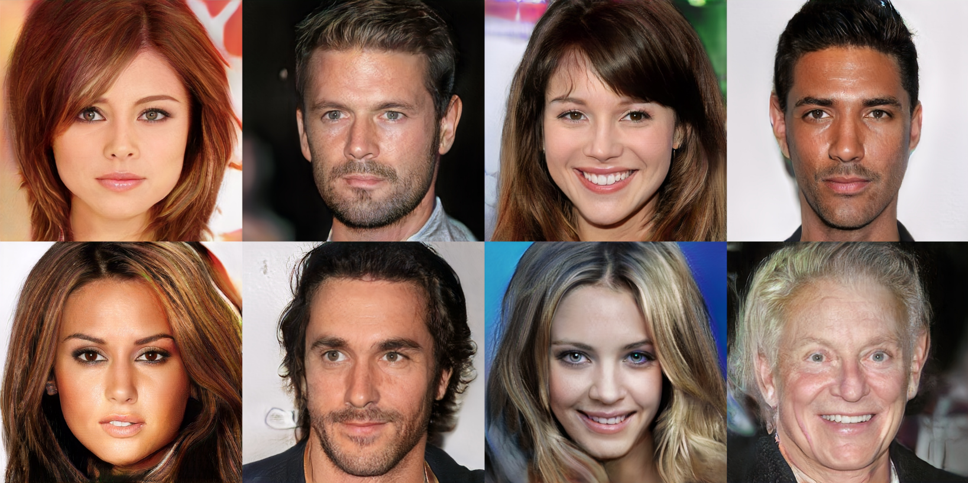
Progressive GAN
https://arxiv.org/abs/1710.10196
Notes:
Are they true?
https://apnews.com/bc2f19097a4c4fffaa00de6770b8a60d?fbclid=IwAR3eEfyonrwxEtJMdRl38xScugscwWi-_2zzoErrbpj1mPVfdEqPuq2CcY0
Is this true???

Slide 18
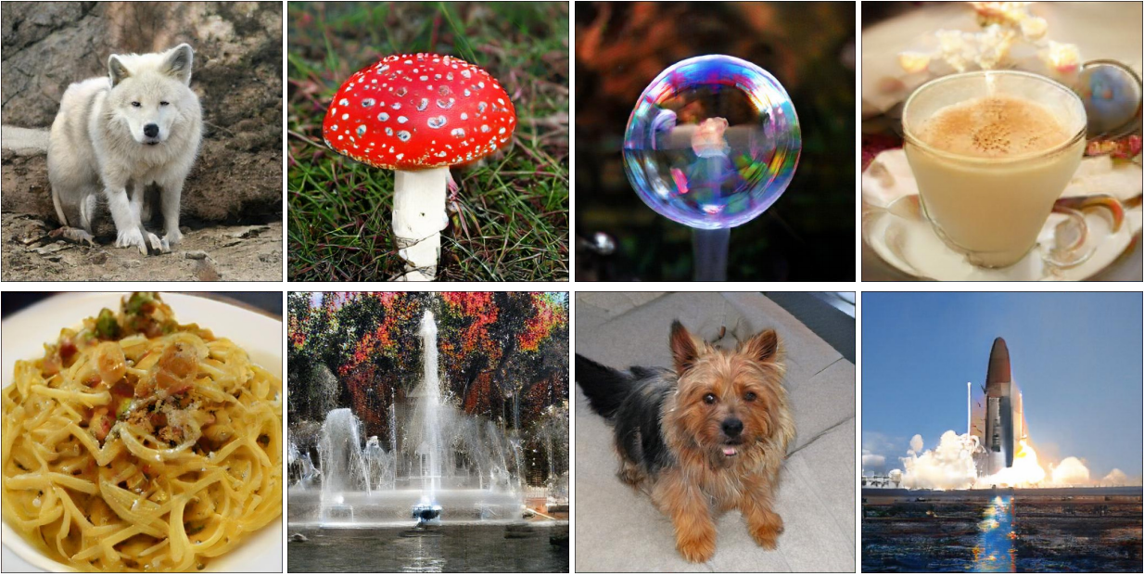
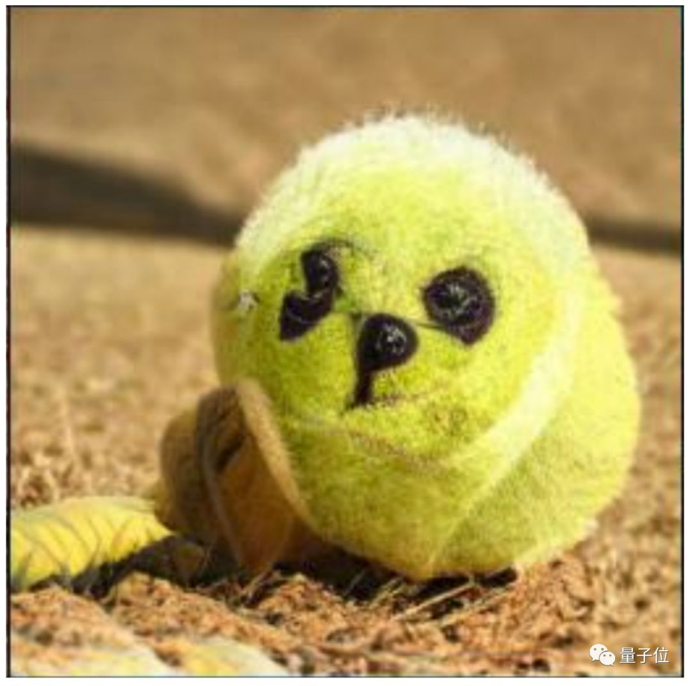
Today …… BigGAN
https://arxiv.org/abs/1809.11096

Slide 19
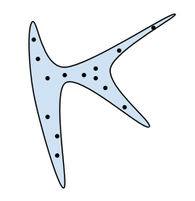
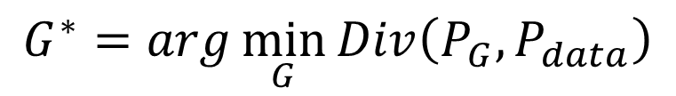
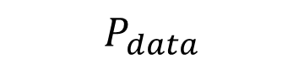
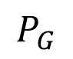
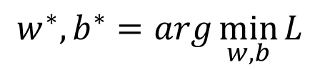
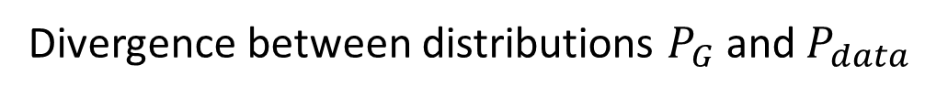
Our Objective
c.f.
$$w^{∗},b^{∗}=arg\min_{w,b}{L}$$
$$P_{G}$$
$$P_{data}$$
Normal Distribution
G
as close as possible
$$G^{∗}=arg\min_{G}{Div\left(P_{G},P_{data}\right)}$$
Divergence between distributions $P_{G}$ and $P_{data}$
How to compute the divergence?
Notes:
A generator G is a network. The network defines a probability distribution $P_{G}$
$x$: an image (a high-dimensional vector)

Slide 20
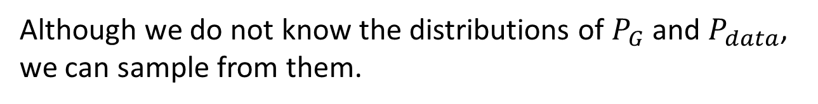
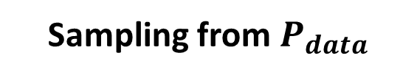
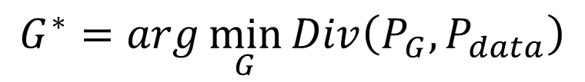
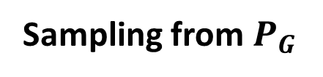
Sampling is good enough ……
$$G^{∗}=arg\min_{G}{Div\left(P_{G},P_{data}\right)}$$
Although we do not know the distributions of $P_{G}$ and $P_{data}$, we can sample from them.
sample
Database
Sampling from $P_{data}$
sample from normal
G
vector
vector
vector
vector
Sampling from $P_{G}$

Slide 21
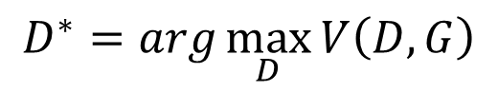
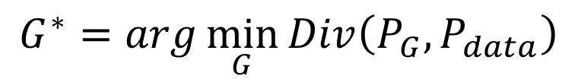
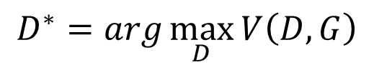
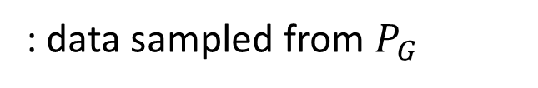
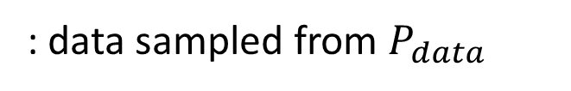
Discriminator
https://arxiv.org/abs/1406.2661
$$G^{∗}=arg\min_{G}{Div\left(P_{G},P_{data}\right)}$$
: data sampled from $P_{data}$
: data sampled from $P_{G}$
Discriminator
class 1
train
Train a binary classifier
class 2
Training:
The value is related to JS divergence.
$$D^{∗}=arg\max_{D}{V\left(D,G\right)}$$
Objective Function for D
$$V\left(G,D\right)=E_{y∼P_{data}}\left[logD\left(y\right)\right]+E_{y∼P_{G}}\left[log\left(1−D\left(y\right)\right)\right]$$
$$D^{∗}=arg\max_{D}{V\left(D,G\right)}$$
Training classifier:
minimize cross entropy
=
negative cross entropy
Notes:
(G is fixed)

Slide 22



$$G^{∗}=arg\min_{G}{Div\left(P_{G},P_{data}\right)}$$
$$\max_{D}{V\left(G,D\right)}$$
$$D^{∗}=arg\max_{D}{V\left(D,G\right)}$$
The maximum objective value is related to JS divergence.
Initialize generator and discriminator
In each training iteration:
Step 1: Fix generator G, and update discriminator D
Step 2: Fix discriminator D, and update generator G

Slide 23




JS divergence is not suitable
In most cases, $P_{G}$ and $P_{data}$ are not overlapped.
1. The nature of data
2. Sampling
Both $P_{data}$ and $P_{G}$ are low-dim manifold in high-dim space.
$$P_{G}$$
$$P_{data}$$
The overlap can be ignored.
Even though $P_{data}$ and $P_{G}$ have overlap.
If you do not have enough sampling ……

Slide 24










What is the problem of JS divergence?
JS divergence is always log2 if two distributions do not overlap.
$$P_{G_{0}}$$
$$P_{data}$$
$$P_{G_{1}}$$
$$P_{data}$$
$$P_{G_{100}}$$
$$P_{data}$$
……
Equally bad
$$JS\left(P_{G_{0}},P_{data}\right)$$
$$=log2$$
$$JS\left(P_{G_{1}},P_{data}\right)$$
$$=log2$$
$$JS\left(P_{G_{100}},P_{data}\right)$$
$$=0$$
……
Intuition: If two distributions do not overlap, binary classifier achieves 100% accuracy.
The accuracy (or loss) means nothing during GAN training.
Notes:
KL is infinite
The Jensen–Shannon divergence (JSD) {\displaystyle M_{+}^{1}(A)\times M_{+}^{1}(A)\rightarrow [0,\infty {})} is a symmetrized and smoothed version of the Kullback–Leibler divergence {\displaystyle D(P\parallel Q)}

Slide 25




Wasserstein distance
Considering one distribution P as a pile of earth, and another distribution Q as the target
The average distance the earth mover has to move the earth.
$$P$$
$$Q$$
d
$$W\left(P,Q\right)=d$$
Notes:
http://www.wxlhcc.com/product/328294.html

Slide 26




Wasserstein distance
Smaller distance?
Larger distance?
$$P$$
$$Q$$
There are many possible “moving plans”.
Using the “moving plan” with the smallest average distance to define the Wasserstein distance.
Source of image: https://vincentherrmann.github.io/blog/wasserstein/

Slide 27














What is the problem of JS divergence?
$$d_{0}$$
$$d_{1}$$
$$P_{G_{0}}$$
$$P_{data}$$
$$P_{G_{1}}$$
$$P_{data}$$
$$P_{G_{100}}$$
$$P_{data}$$
……
$$JS\left(P_{G_{0}},P_{data}\right)$$
$$=log2$$
$$JS\left(P_{G_{1}},P_{data}\right)$$
$$=log2$$
……
$$JS\left(P_{G_{100}},P_{data}\right)$$
$$=0$$
$$W\left(P_{G_{0}},P_{data}\right)$$
$$=d_{0}$$
$$W\left(P_{G_{1}},P_{data}\right)$$
$$=d_{1}$$
$$W\left(P_{G_{100}},P_{data}\right)$$
$$=0$$
……
Better!

Slide 28



WGAN
https://arxiv.org/abs/1701.07875
Evaluate Wasserstein distance between $P_{data}$ and $P_{G}$
$$\max_{D∈1−Lipschitz}\left\{E_{y\sim P_{data}}\left[D\left(y\right)\right]−E_{y\sim P_{G}}\left[D\left(y\right)\right]\right\}$$
D has to be smooth enough.
How to fulfill this constraint?
$$∞$$
Without the constraint, the training of D will not converge.
generated
real
Keeping the D smooth forces D(y) become $∞$ and $−∞$
D
$$−∞$$
Notes:
利普希茨連
Simply speaking

Slide 29

$$\max_{D∈1−Lipschitz}\left\{E_{y\sim P_{data}}\left[D\left(y\right)\right]−E_{y\sim P_{G}}\left[D\left(y\right)\right]\right\}$$
Original WGAN $→$ Weight
Improved WGAN $→$ Gradient Penalty
Spectral Normalization $→$ Keep gradient norm smaller than 1 everywhere
Force the parameters w between c and -c
After parameter update, if w > c, w = c; if w < -c, w = -c
Keep the gradient close to 1
https://arxiv.org/abs/1704.00028
samples
https://arxiv.org/abs/1802.05957
Notes:
Spectral Normalization !!!
DraGAN (Deep Regret Analytic Generative Adversarial Networks)
Demo on toy examples
https://github.com/t-vi/pytorch-tvmisc/blob/master/wasserstein-distance/Improved_Training_of_Wasserstein_GAN.ipynb
Improved GRAGAN, SLOGAN
https://lernapparat.de/more-improved-wgan/
https://arxiv.org/pdf/1704.00028.pdf

Slide 30
GAN is still challenging …
Generator and Discriminator needs to match each other (棋逢敵手)
Generate fake images to fool discriminator
Cannot fool the discriminator …
Fail to improve ...
Generator
Discriminator
Fail to improve ...
I cannot tell the difference ……
Tell the difference between real and fake
Notes:
寫作敵人，唸做朋友

Slide 31







Possible Solution?
$$\left[\begin{aligned}0.3 \\ −0.1 \\ ⋮ \\ −0.7\end{aligned}\right]$$
$$\left[\begin{aligned}0.1 \\ −0.1 \\ ⋮ \\ 0.7\end{aligned}\right]$$
$$\left[\begin{aligned}−0.3 \\ 0.1 \\ ⋮ \\ 0.9\end{aligned}\right]$$
$$\left[\begin{aligned}0.7 \\ 0.1 \\ ⋮ \\ −0.9\end{aligned}\right]$$
$$\left[\begin{aligned}−0.1 \\ 0.8 \\ ⋮ \\ 0.8\end{aligned}\right]$$
$$\left[\begin{aligned}0.3 \\ −0.1 \\ ⋮ \\ −0.7\end{aligned}\right]$$
Network
Using typical learning approaches?
Generative Latent Optimization (GLO), https://arxiv.org/abs/1707.05776
Gradient Origin Networks, https://arxiv.org/abs/2007.02798

Slide 32
Evaluation of Generation

Slide 33


Quality of Image
Human evaluation is expensive (and sometimes unfair/unstable).
How to evaluate the quality of the generated images automatically?
class 2
image
Off-the-shelf Image Classifier
$$y$$
$$P\left(c|y\right)$$
class 1
class 3
e.g., Inception net, VGG, etc.
Concentrated distribution means higher visual quality

Slide 34

Diversity - Mode Collapse
: real data
: generated data

Slide 35


Diversity - Mode Dropping
: real data
: generated data
Generator
at iteration t
Generator
at iteration t+1
(BEGAN on CelebA)

Slide 36








Diversity
class 2
$$P\left(c|y^{1}\right)$$
$$y^{1}$$
CNN
$$P\left(c\right)$$
class 1
class 3
$$=\frac{1}{N}\sum_{n}{P\left(c|y^{n}\right) }$$
class 2
$$P\left(c|y^{2}\right)$$
$$y^{2}$$
CNN
class 1
class 3
class 2
class 2
class 1
class 3
$$y^{3}$$
CNN
$$P\left(c|y^{3}\right)$$
low diversity
class 1
class 3
……

Slide 37

Diversity
Inception Score (IS):
Good quality, large diversity $→$ Large IS
class 2
$$P\left(c|y^{1}\right)$$
$$y^{1}$$
CNN
$$P\left(c\right)$$
class 1
class 3
$$=\frac{1}{N}\sum_{n}{P\left(c|y^{n}\right) }$$
class 1
$$P\left(c|y^{2}\right)$$
$$y^{2}$$
CNN
class 2
class 3
class 3
Uniform means higher variety
$$y^{3}$$
CNN
class 1
$$P\left(c|y^{3}\right)$$
class 2
……
What is the problem here? ☺

Slide 38
Fréchet Inception Distance (FID)
https://arxiv.org/pdf/1706.08500.pdf
red points: real images
CNN
blue points: generated images
softmax
FID = Fréchet distance between the two Gaussians
???
Smaller is better
Notes:
[Martin Heusel, et al., NIPS, 2017]

Slide 39
We don’t want memory GAN.
https://arxiv.org/pdf/1511.01844.pdf
Real Data
Generated Data
Same as real data …
Generated Data
Simply flip real data …
Notes:
reverse
Using k-nearest neighbor to check whether the generator generates new objects

Slide 40
Conditional Generation

Slide 41






Text-to-image
red eyes
yellow hair
$$x$$
black hair
dark circles
red eyes
Generator
$$y$$
$$z$$
red hair, green eyes
blue hair, red eyes
Notes:
The images are generated by Yen-Hao Chen, Po-Chun Chien, Jun-Chen Xie, Tsung-Han Wu.
===
You define the dimension! How to determine your dim???
===
We will control what to generate latter. $→$ Conditional Generation

Slide 42






Conditional GAN
$x$: Red eyes
G
Image
$$y=G\left(c,z\right)$$
Normal distribution
$$z$$
$y$ is real image or not
D
(original)
$$y$$
scalar
Generator will learn to generate realistic images ….
But completely ignore the input conditions.
Real images:
1
Generated images:
0

Slide 43



Conditional GAN
https://arxiv.org/abs/1605.05396
$x$: Red eyes
G
Image
$$y=G\left(c,z\right)$$
Normal distribution
$$z$$
$$y$$
D
(better)
$y$ is realistic or not +
$x$ and $y$ are matched or not
scalar
$$x$$
True text-image pairs:
(red eyes, )
1
(red eyes, )
0
(red eyes, )
0

Slide 44








Conditional GAN
https://arxiv.org/abs/1611.07004
G
Image
D
scalar
$$z$$
Testing:
input
supervised
GAN
GAN + supervised
Notes:
smoketak

Slide 45

Conditional GAN
Talking Head Generation
https://arxiv.org/abs/1905.08233
Notes:
1Samsung AI Center, Moscow

Slide 46
Learning from Unpaired Data

Slide 47












Learning from Unpaired Data
Deep
Network
$$x$$
$$y$$
$$x^{1}$$
$$y^{2}$$
$$x^{3}$$
$$x^{7}$$
$$y^{4}$$
$$y^{10}$$
$$x^{5}$$
$$y^{8}$$
$$y^{6}$$
$$x^{9}$$
unpaired
HW3: pseudo labeling
HW5: back translation
Still need some paired data

Slide 48







Learning from Unpaired Data
Deep
Network
$$x$$
$$y$$
Image Style Transfer
Domain $𝒳$
Domain $𝒴$
unpaired
Can we learn the mapping without any paired data?
Unsupervised Conditional Generation

Slide 49


Learning from Unpaired Data
Domain $𝒳$
Domain $𝒴$
Network
Notes:
New input z which is a random variable
You may be confused about how to add z.

Slide 50








Cycle GAN
Domain $𝒳$
Domain $𝒴$
Domain $𝒳$
Become similar to domain $𝒴$
$$G_{𝒳→𝒴}$$
?
$$D_{𝒴}$$
scalar
Input image belongs to domain $𝒴$ or not
Domain $𝒴$
Notes:
https://arxiv.org/abs/1703.10593
https://junyanz.github.io/CycleGAN/
Berkeley AI Research (BAIR) laboratory, UC Berkeley

Slide 51
Cycle GAN
Domain $𝒳$
Domain $𝒴$
Domain $𝒳$
Become similar to domain $𝒴$
$$G_{𝒳→𝒴}$$
?
ignore input
$$D_{𝒴}$$
scalar
Input image belongs to domain $𝒴$ or not
Domain $𝒴$
Notes:
https://arxiv.org/abs/1703.10593
https://junyanz.github.io/CycleGAN/
Berkeley AI Research (BAIR) laboratory, UC Berkeley

Slide 52





Cycle GAN
as close as possible
Cycle consistency
$$G_{𝒳→𝒴}$$
$$G_{𝒴→𝒳}$$
“Related” to input, so possible to reconstruct
$$D_{𝒴}$$
scalar
Input image belongs to domain $𝒴$ or not
Domain $𝒴$

Slide 53





Cycle GAN
as close as possible
Cycle consistency
$$G_{𝒳→𝒴}$$
$$G_{𝒴→𝒳}$$
scalar: belongs to domain $𝒳$or not
$$D_{𝒳}$$
$$D_{𝒴}$$
scalar
$$G_{𝒴→𝒳}$$
$$G_{𝒳→𝒴}$$

Slide 54


StarGAN
https://arxiv.org/abs/1711.09020

Slide 55



https://selfie2anime.com/
https://arxiv.org/abs/1907.10830
Notes:
Should I talk about the method they used??????????????
South Korean Team
Yui

Slide 56
資料來源
https://speech.ee.ntu.edu.tw/~hylee/ml/ml2021-course-data/gan_v10.pptx

